Slide 1
Power BI Dataflows
Notes:
This module provides an introduction to developing custom data connectors using the Power Query SDK. The module explains the motivation for creating custom data connectors and walks through how to get started creating custom data connector projects using Visual Studio and the Power Query SDK. Students will learn how to write shared functions in M that are accessible to queries created in Power BI Desktop. The module explains how to package a custom data connector as well as how to test it using Power BI Desktop. The module discusses how to design a custom data connector for a specific type of authentication such as connecting to a Software-as-a-Service (SaaS) applications using OAuth2. Along the way, students will learn to develop a custom data connector that authenticates against Azure Active Directory and extracts data by executing queries using the Microsoft Graph API.

Slide 2
Agenda
What are dataflows?
Configuring, creating and consuming dataflows
Why use dataflows?
Linked and computed entities
AI features in dataflows
Dataflows and the Common Data Model
Roadmap

Slide 3
What are dataflows?
Self-service ETL tool in the Power BI cloud service
Not Azure Data Factory
Not Microsoft Flow
Power Query in the cloud/in the browser plus a lot more
They split the extraction/preparation away from datasets
They allow for sharing of tables of data between datasets
They do not allow sharing of dataset features like relationships and DAX calculations

Slide 4
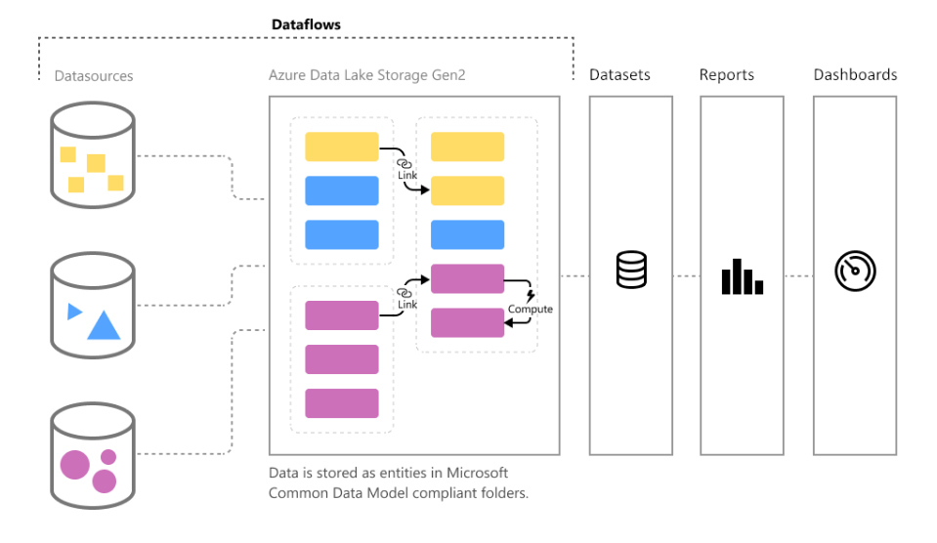
The Big Picture

Slide 5
Licensing
Not available in My Workspace or for Power BI Free users
Most features available for Power BI Pro users in an app workspace
Premium gives you:
Ability to handle larger data volumes
Better refresh performance
Linked and computed entities
Ability to use AI features to transform data (coming soon)

Slide 6
Concepts
A dataflow exists within a workspace
One dataflow contains one or more entities
An entity is:
A table of data plus some metadata
The output of a Power Query M query or some other process

Slide 7
Dataset A
Table X
Table X
Table X
Dataset B
Data Source
Power BI Workspace

Slide 8
Dataset A
Table X
Table X
Entity X
Entity X
Dataset B
Data Source
Power BI Dataflow
Power BI Workspace

Slide 9
Configuring dataflows
Enable “Create and use dataflows” in the Admin Portal
Dataflows are a workload in a Premium capacity
Therefore also needs to be enabled in the Capacity Settings section of the Admin Portal before you can use them on a Premium capacity
How much memory do you want to allocate?
Link to bring-your-own Azure storage also needs to be configured in the Admin Portal
Some features are only available in “New” workspaces

Slide 10
Creating dataflows
Create a dataflow in a workspace
Create entities in the dataflow using Power Query Online
Copying and pasting M code from Power BI Desktop into a new blank query may be a better idea for now
Save and close
Refresh

Slide 11
Consuming dataflows
Entities can be consumed in Power BI Desktop by using the “Power BI dataflows” source
You can make your own transformations as normal in the Power Query Editor in Power BI Desktop
Datasets that use entities as a data source can be published to any workspace
Not just the workspace that contains the dataflow

Slide 12
Why use dataflows?
Not a replacement for a data warehouse, but useful when:
There is no data warehouse in your organisation
Data warehouse does not contain the data you need
Reduces overall data refresh time:
Extracting once and re-using multiple times means you only pay the performance price for the initial slow extract once
Reading data from a dataflow is fast, probably much faster than extracting data from the original source
Computed entities may be faster than referencing

Slide 13
Why use dataflows?
Reduces load on/number of calls to source system
Eg when refresh could affect the performance of a line-of-business database
Eg when there is a limit on the number of calls to an API
More consistency between datasets – less chance that different users will make different decisions when preparing data
Share complex M queries that some users would not be able to write
Share tables that have no source, eg Date dimensions generated in M

Slide 14
Linked entities (Premium only)
Linked entities let you share data between
Different dataflows in the same Workspace
Different dataflows in different Workspaces
Do not duplicate data from the source entity
Specifically: use an existing entity in another workspace as a source
Uses the same M code a dataset uses to get data from an entity
Linked entities are read-only
If you want to do further transformations you must create a computed entity
Diagram view makes it easy to see usage of linked entities

Slide 15
Entity X
Entity X
Table X
Table X
Dataset A
Linked Entity X
Linked Entity X
Dataset B
Data Source
Power BI Dataflows
Power BI Workspaces

Slide 16
Computed Entities
Computed entities let entities use other entities as data sources
A bit like referencing – but uses the persisted output of the source entity as the input
Referencing is still possible between Entities in the same Dataflow – just turn off the “Enable load” option
Useful if:
You are creating multiple entities within a dataflow from the same raw data, and don’t want to get data from the original data source more than once
You are hitting problems as a result of the Power Query engine’s habit of requesting data multiple times during a single query execution

Slide 17
Table X
Table X
Dataset A
Entity X
Entity Y
Entity Y
Data Source
Power BI Dataflow
Power BI Workspace

Slide 18
Refresh
Dataflows can be refreshed manually or on a schedule
Entities in dataflows stored in a Premium capacity can use incremental refresh
Great for data warehouse style refresh scenarios
But how do I just add new data onto my existing data…?
Linked entities in the same workspace are automatically refreshed when the source dataflow is refreshed
Linked entities in different workspaces are not automatically refreshed when the source dataflow is refreshed

Slide 19

Sample Production Dataflow Design
Sources
20
Ingest from Dynamics Sales
22 entities
8
Clean and enrich sales data
10 entities
CRM – Production
Dynamics 365
10
Final Business View
11 entities
4
1
1
IoT Signal
Azure Data Lake Storage
Product Telemetry in Azure
5 entities
4
Add Telemetry Customer Attributes
6 entities
1
Azure Analysis Services
Sales/Telemetry Reference Data
Dataflow

Slide 20
AI Features
Power BI Premium users will soon get extra AI/machine learning features for data preparation
Another separate workload inside your Premium capacity
These include:
Call Cognitive Services functions (eg detect sentiment, language, tag images) as steps in a query
Creation and training of simple machine learning models (Binary Prediction, Classification, Regression, Forecasting)
Call machine learning models built in Azure Machine Learning

Slide 21
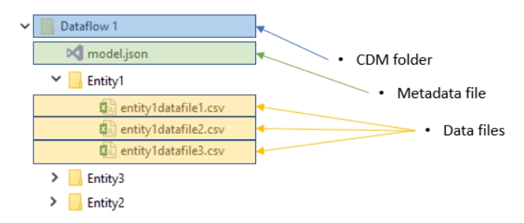
Storage
Entities are stored in one or more CSV files
There is also JSON metadata file for the dataflow
The format is defined by the Common Data Model specification
Everything is stored in Azure Data Lake Gen2 Storage
By default this is owned and managed by Power BI, so you don’t see it
You can also bring your own Azure storage, which allows for:
Larger data volumes
Access to this data by other services

Slide 22
Common Data Model integration
The Common Data Model provides a:
Simple, consistent way of describing data
Common, extensible schema for business entities
Dataflow output is stored in CDM format
Dataflow entities can be mapped to CDM Entities
Joint initiative between Microsoft, Adobe and SAP
See https://github.com/Microsoft/CDM for more information

Slide 23
Common Data Model Integration
Aim is make it easy to share data between multiple services
Other applications and services are able to:
Read data from entities created by Power BI Dataflows
Output data to CDM folders which can then be attached as Dataflows by Power BI users
Integration planned with Azure Data Factory, Azure SQL DW, Azure Machine Learning and Azure Databricks

Slide 24
User education
Dataflows are for end-users, or at least power-users
But will these users plan ahead enough in order to use them?
User education will be key:
Create some dataflows for them to use and learn from
Look at existing datasets for duplicated tables and help users to refactor to use dataflows
Look at dataset refresh times and see if dataflows might help
Restricting access to data sources might encourage more use of dataflows?

Slide 25
Roadmap
Power Query Online (as used by dataflows) will be functionally equivalent to Power Query in Power BI Desktop
Performance and scalability enhancements for working with large data volumes
Ability to refresh dataset after a dataflow it depends on has refreshed
Ability to create dataflows though the API
Lots of interesting features in the CDM specification…?

